Slide 2
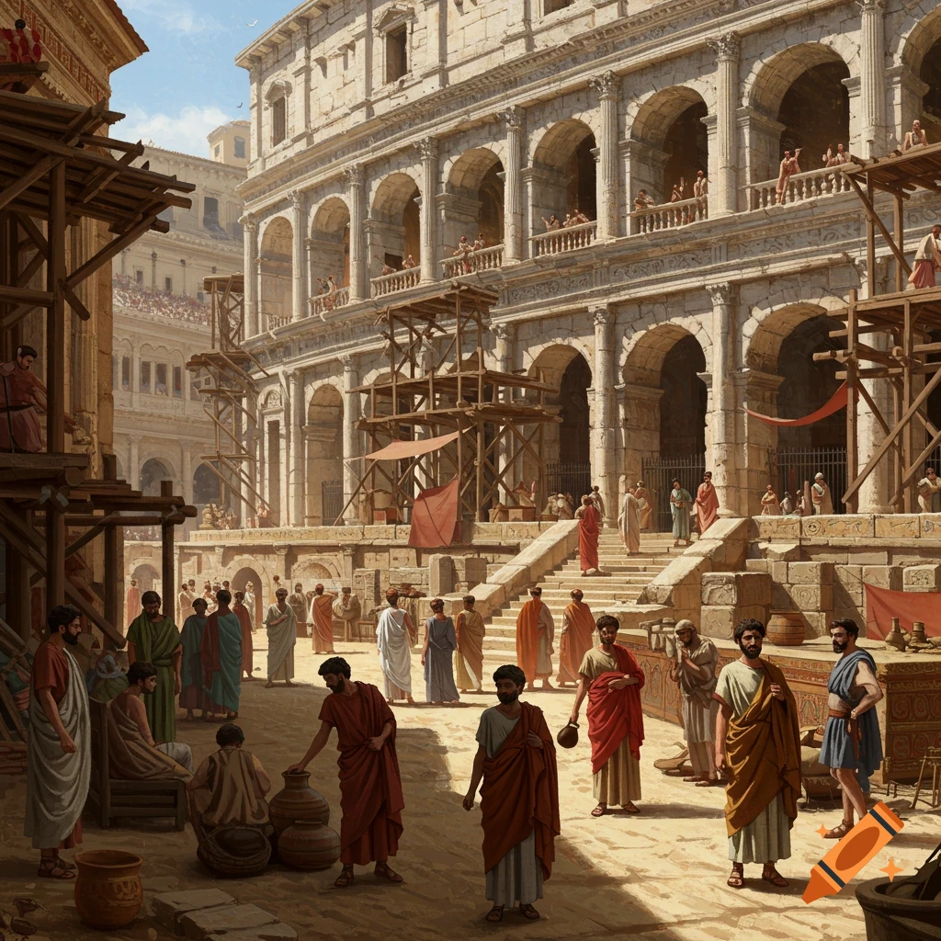
Ancient Churches in Modern Times
Ephesus

Slide 3
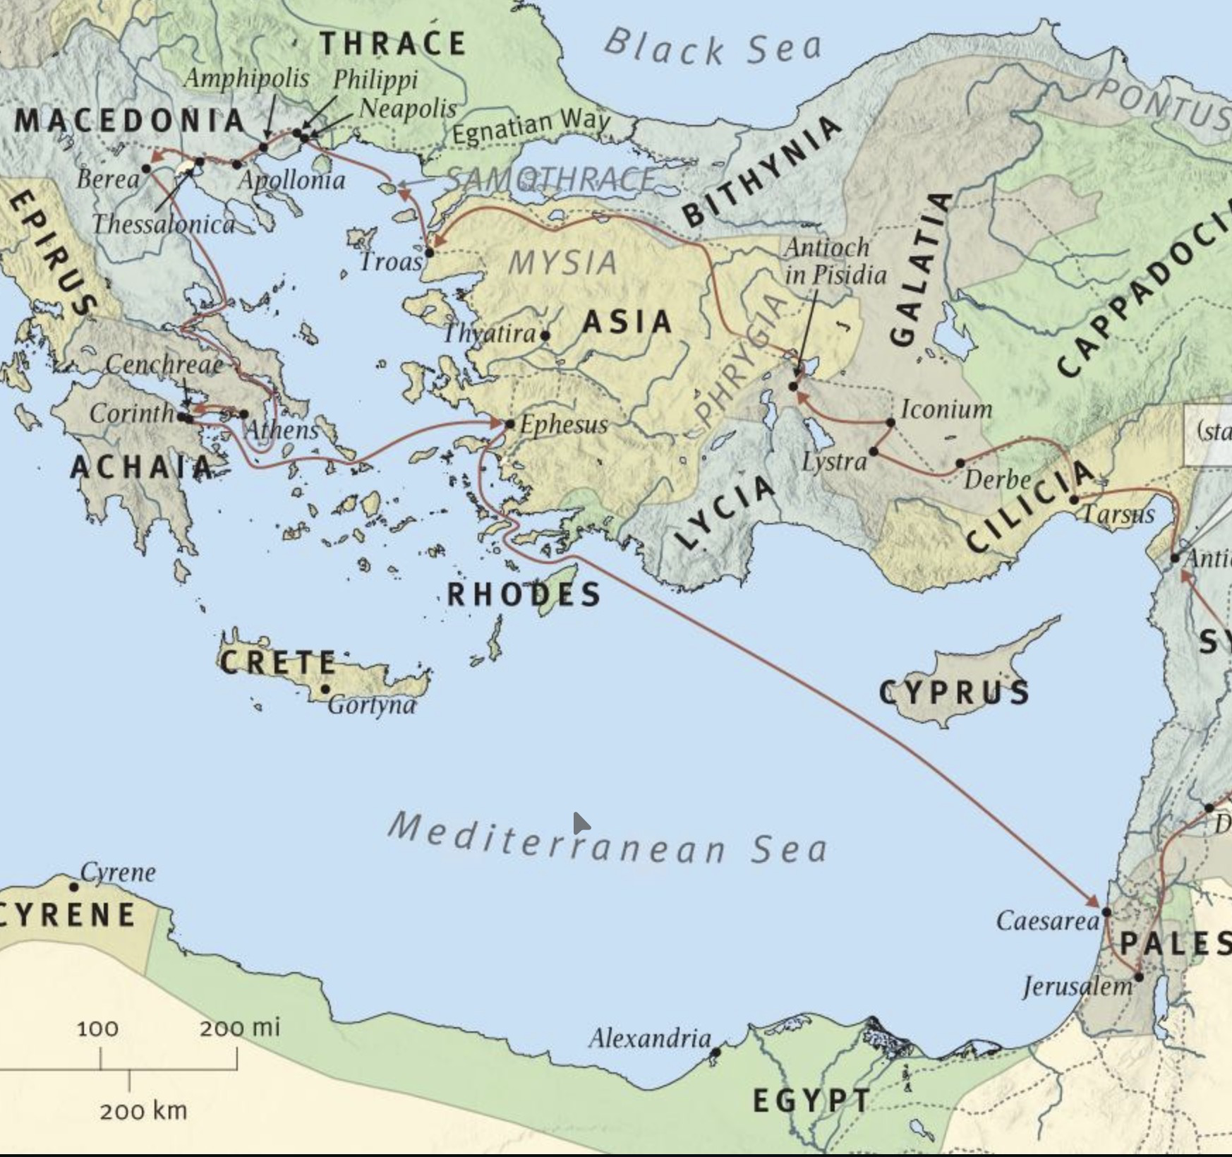
Ephesus
In modern day
TURKEY

Slide 4
The MOST complete history
~52-90 AD
Paul leaves Aquila and Priscilla there Acts - 18a
Apollos, corrected - 18b
Paul teaches for 3 years (longest stent) - 19
Paul meets with the elders the next year 20
Ephesians is written
1-2 Timothy is written
Revelation is written
John dies there (historically)

Slide 5
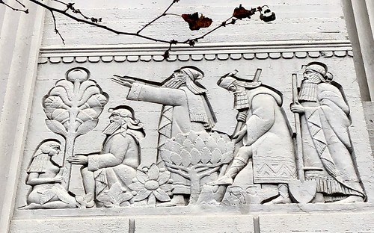
Humble Beginnings
Acts 18b-19
Powerful couple
Humble mistaken men
Radical Repentance
Discipling
Disrupting?

Slide 6
God’s Roadmap for a church
Acts 20:17-38
1-2 Timothy, Ephesians
The WHY -> the WHAT (Eph.1/4)
Work HARD (33-35)
Teach the WORD (32) and teach all of it (27)
Elders/Shepherds, Evangelists & Teachers needed (17, 28, 2 Tim 4:5, 2 Tim. 2:2)

Slide 7
The “Strong” church?
Revelation 2:1-7
Worked hard
Stood for the truth
Persevered for Jesus!
But what was your motivation? Ezk.16.22, Zech 7.5

Slide 8
Ancient Churches in Modern Times do we…
live radical repentance?
live radical service?
live radical devotion to our Lord?

